Slide 1




A Complete Guide to Programming in C++
Chapter 18 - Fundamentals of File Input and Output

Slide 2
File Operations
Single characters or character strings can be written to text files just like they can be output on screen. However, it is common practice to store records in files. A record contains data that forms a logical unit, such as the human resource information for a person. A write operation stores a record in a file, that is, the existing record in the file is updated or a new record is added. When you read a record, this record is taken from the file and copied to the data structure of a program.
Objects can be put into permanent storage using similar techniques. However, this normally involves more than just storing an object’s data. You also need to ensure that the object can be correctly reconstructed when it is read, and this in turn involves storing type information and references to other objects.
External mass storage media, such as hard disks, are normally block-oriented—that is, data is transferred in blocks whose size is a multiple of 512 bytes. Efficient and easy file management thus implies putting the data you need to store into temporary storage in main memory, in a so-called file buffer

Slide 3
File positions
From the viewpoint of a C++ program, a file is simply a long byte array. The structure of the file, using records for example, is entirely the programmer’s responsibility, allowing for a maximum degree of flexibility.
Every character in a file occupies a byte position. The first byte occupies position 0, the second byte position 1, and so on. The current file position is the position of the byte that will be read or written next. Each byte that is transferred automatically increases the current file position by 1.
In the case of sequential access, the data is read or written byte by byte in a fixed order. The first read operation starts at the beginning of the file. If you need access to some piece of information in a file, you must read the file content from start to finish. Write operations can create a new file, overwrite an existing file, or append new data to an existing file.
Easy access to given data in a file implies being able to set the current file position as required. This technique is known as random file access and will be discussed in one of the following chapters.

Slide 4
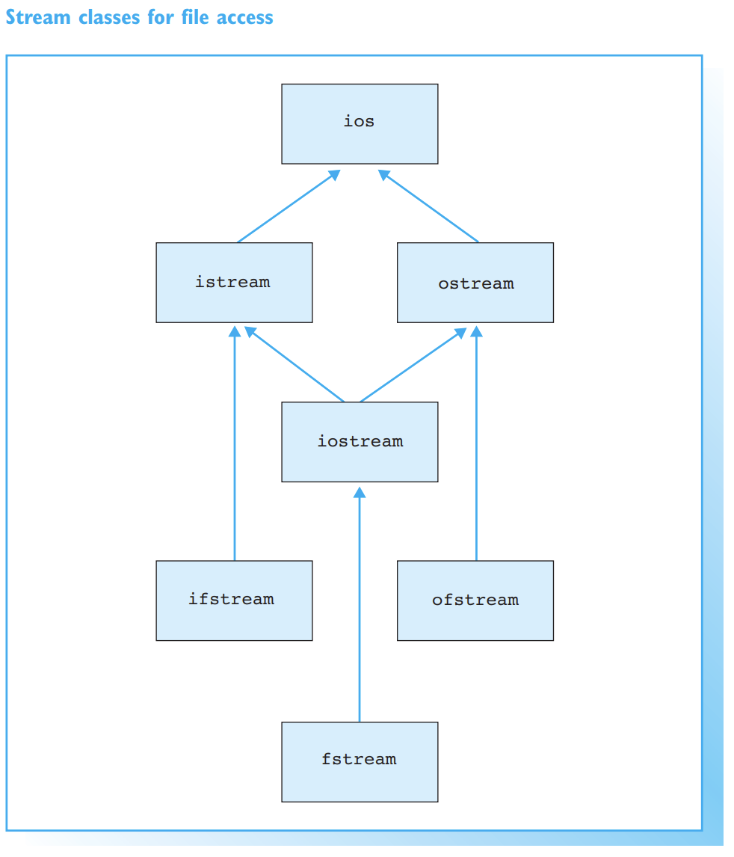

File Streams
C++ provides various standard classes for file management. These so-called file stream classes allow for easy file handling. As a programmer you will not need to concern yourself with file buffer management or system specifics.
Since the file stream classes have been standardized, you can use them to develop portable C++ programs. One program can thus process files on a Windows NT or UNIX platform. You simply need to recompile the program for each platform you use.

Slide 5
The File Stream Classes in the iostream Library
The class hierarchy on the opposite page shows that the file stream classes contain the stream classes, with which you are already familiar, as base classes:
the ifstream class derives from the istream class and allows file reading
the ofstream class derives from the ostream stream class and supports writing to files
the fstream class derives from the iostream stream class. As you would expect, it supports both read and write operations for files.
The file stream classes are declared in the fstream header file. An object that belongs to a file stream class is known as a file stream.

Slide 6
Functionality
The file stream classes inherit the functionality of their base classes. Thus, the methods, operators, and manipulators you have already used for cin and cout are also available here. Thus every file stream has:
methods for non-formatted writing and reading of single characters and/or data blocks
the operators << or >> for formatted reading and writing from or to files
methods and manipulators for formatting character sequences
methods for state queries.
File handling methods, particularly methods for opening and closing files, round off the package.

Slide 7
Opening a File
You need to open a file before you can manipulate it. To do so, you can
state the file name, which can also contain a path
define a so-called file access mode.
If the path is not explicitly stated, the file must be in the current directory. The file access mode specifically defines whether read and/or write access to the file is permitted.
Any files still open when a program terminates are automatically closed.

Slide 8
File Stream Definition
You can open a file when you create a file stream—you simply state the file name to do so. In this case default values are used for the file access mode.
The file name test.fle is passed to the constructor of the ifstream class, which opens the file for reading. Since the path was not stated, the file must be in the current directory. When a file is opened, the current file position is the beginning of the file.

Slide 9
File Stream Definition
If you create a file stream for write-only access, the file you state need not exist. In this case a new file is created.
This statement creates a new file called new.fle and opens the file for writing. But be careful! If the file already exists, it will be truncated to a length of zero bytes, or in other words deleted.

Slide 10

File Stream Definition
You can create a file stream which does not reference a specific file and use the open() method to open a file later.
This example has the same effect as the previous example. More specifically, open() uses the same default values for file access when opening a file as the default constructor for the class.
It rarely makes sense to use fixed file names. In the case of the sample program on the opposite page, you state the file name in the command line when you launch the program. If no file name is supplied, the program issues an error message and terminates. Using interactive user input is another possible way to define a file name.

Slide 11

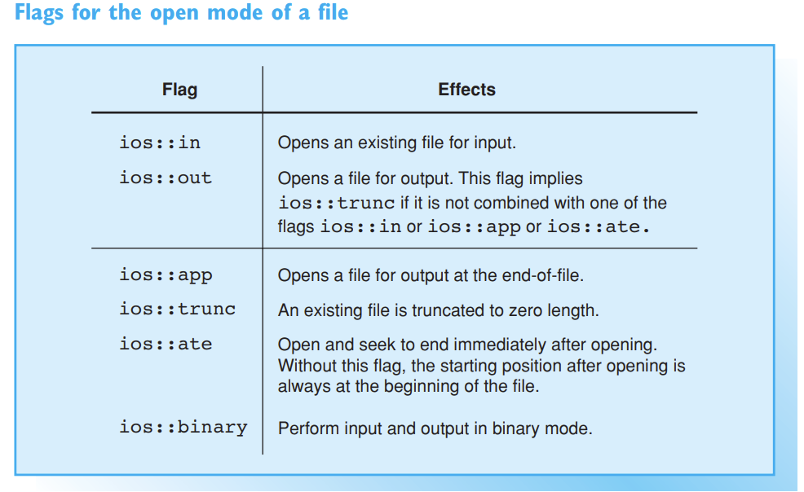

Open modes
To open a file in any but the default mode, you must supply both the file name and the open mode. This is necessary, for example, to open an existing file for write access without deleting the file.
In addition to the file name, you can pass a second argument for the open mode to the constructors and the open() method. The open mode is determined by using flags. A flag represents a single bit in a computer word. If the flag is raised, the bit in question will contain the value 1, with 0 representing all other cases.

Slide 12
Open mode flags
You can use the bit operator, |, to combine various flags. Either the flag ios::in or ios::out must be stated in all cases. If the flag ios::in is raised, the file must already exist. If the flag ios::in is not used, the file is created, if it does not already exist.
This opens a file for writing at end-of-file. The file is created, if it does not already exist. The file will automatically grow after every write operation.
You can use the default mode for the fstream class, that is, ios::in | ios::out, to open an existing file for reading and writing. This so-called update mode is used for updating the information in a file and is often seen in conjunction with random file access.

Slide 13
Error Handling
Errors can occur when opening a file. A user may not have the required access privileges, or the file you want to read may not exist. The state flag failbit of the ios base class is raised in this case. The flag can either be queried directly using the fail() method, or indirectly by querying the status of a file stream in an if condition.
The fail bit is also set if a read or write error occurs. If a read operation fails, the end of the current file may have been reached. To distinguish this normal behavior from a read error, you can use the eof() method (eof = end-of-file) to query the eof bit:
The eof bit is set if you try to carry on reading at the end of a file.

Slide 14
Closing files
After you have completed file manipulation, the file should always be closed for the following reasons:
data may be lost, if for some reason the program is not terminated correctly
there is a limit to the number of files that a program can open simultaneously.
A program that terminates correctly will automatically close any open files before exiting. A file stream destructor will also close a file referenced by a stream. However, if the file is no longer in use before this point, you should close the file explicitly

Slide 15

Methods close() and is_open()
Each of the file stream classes contains a definition of a void type method called close(), which is used to close the file belonging to the stream.
However, the file stream continues to exist. It is therefore possible to use the stream to open and manipulate another file. If you are not sure whether a file stream is currently accessing a file, you can always perform a test using the is_open() method . In the case of the myfile file stream, the test is as follows:
.

Slide 16
The exit() Function
Open files are also closed when you call the global function exit(). The actual reason for using this function is to terminate a program in an orderly manner and return an error code to the calling process.
The calling process, to which the status error code is passed for evaluation, will often be the command interpreter—a Unix shell, for example. Successful program execution normally produces the error code 0. The statement return n; is thus equivalent to the statement exit(n); when used in the main() function.

Slide 17
Examples
Let's get to coding!

